Slide 1

Data Science Capstone Project 2021 The Battle of the Neighborhood
By Marcos Fugulin

Slide 2
Introduction
Due to the "Lockdown" in 2020, several restaurants closed their doors, with the need to adapt their ways of serving their customers. Two forms of service were established by most restaurants and snack bars: delivery and on-site collection (courtside pick up), as they present the lowest initial investment.
Thus, some entrepreneurs thought of themselves starting the process of delivering products to their customers, within a restricted distance area.
This is an excellent opportunity to create a model that can be suitable for any restaurant that wants this analysis, helping small business owners to adapt their businesses, get to know the competition better, and make a better investment decision in this service (or not). It is time to reinvent themselves!

Slide 3
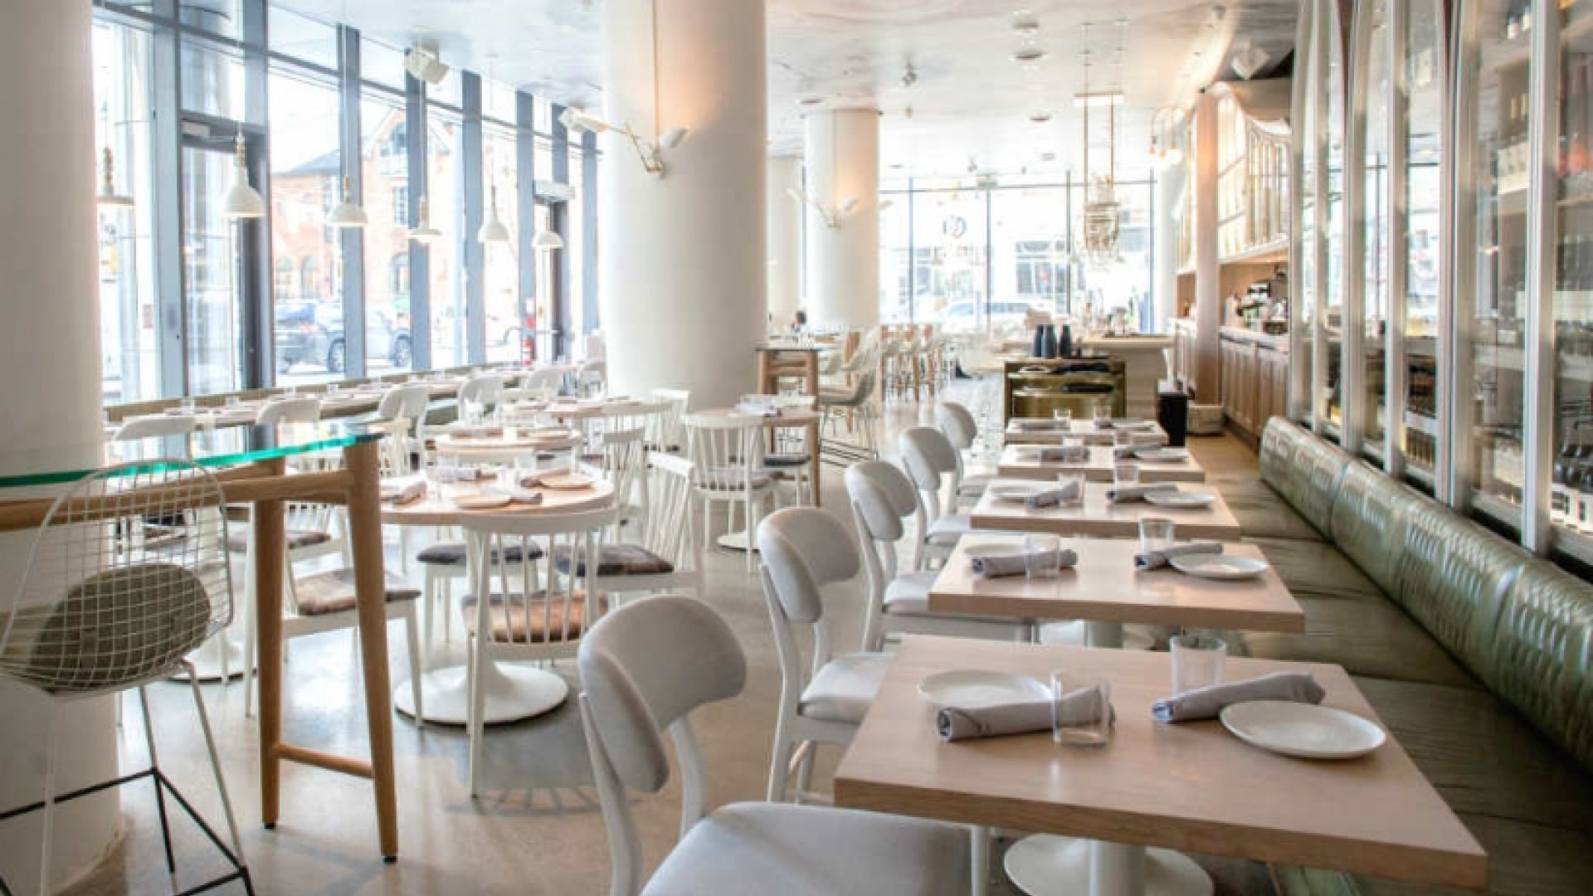
Business Problem
Need to Know better your Neighborhood and competition for delivery services.
How many restaurants are there in the area to offer the analysis?
What types of restaurants are in this region?
What is the income of people in the same region to determine the prices to be charged?
Where is the best area to provide the delivery services with the best return on investment?

Slide 4
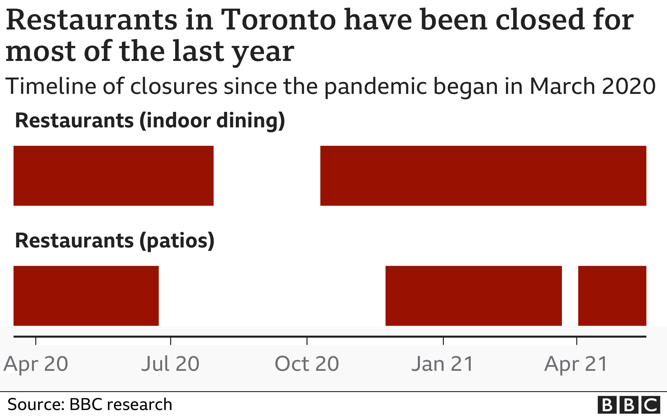
Business Problem
The media expose clearly that are needs, as well as space for changes if the small business owners want to survive to the pandemic.

Slide 5

Our Objective
Offer customizable business model analysis to all small business owners to evaluate the delivery services by them on.
Use Toronto as a reference for the first model to be showed to the market
Evaluate restaurants and population in 5 Km far from Toronto

Slide 6

How will we do that?
Using external databases to capture relevant data and evaluate the results.
Number of restauranter per category
Number of restauranter per neighborhood
Number of people per neighborhood
Evaluate the Clustering
Sources/Databases
Foursquare to find restaurants
Wellbeing Toronto for Demographic/ socioeconomic
Wikipedia to find the locations

Slide 7
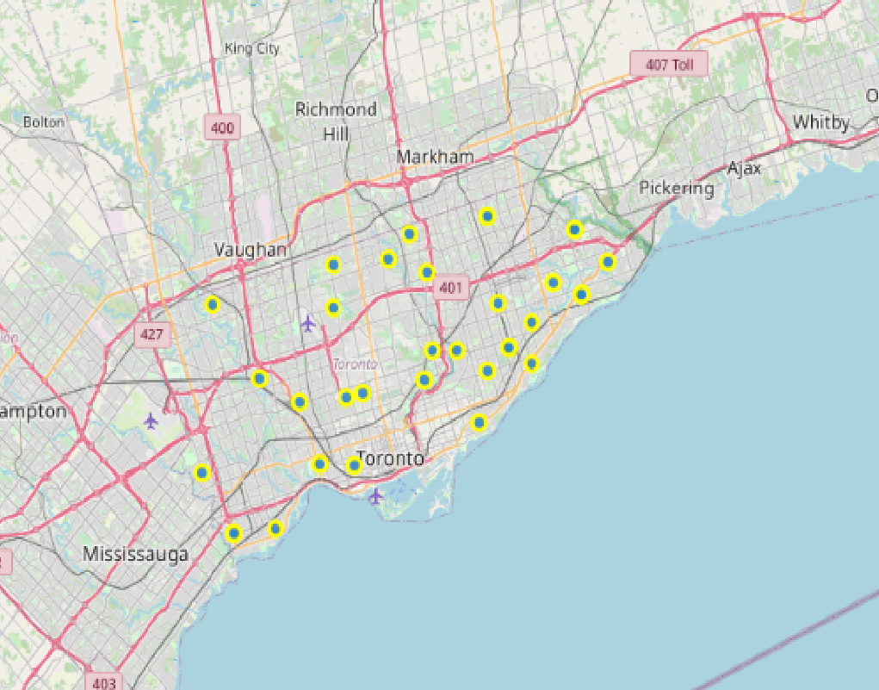
Number of Restaurants
There are 50 Restaurants, under 5 Km Range from Toronto that we can offer these services

Slide 8
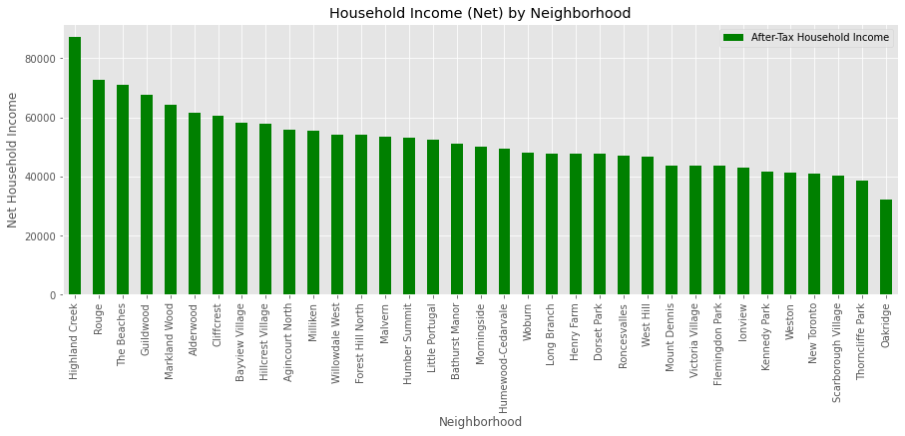
Household Income (Net)

Slide 9
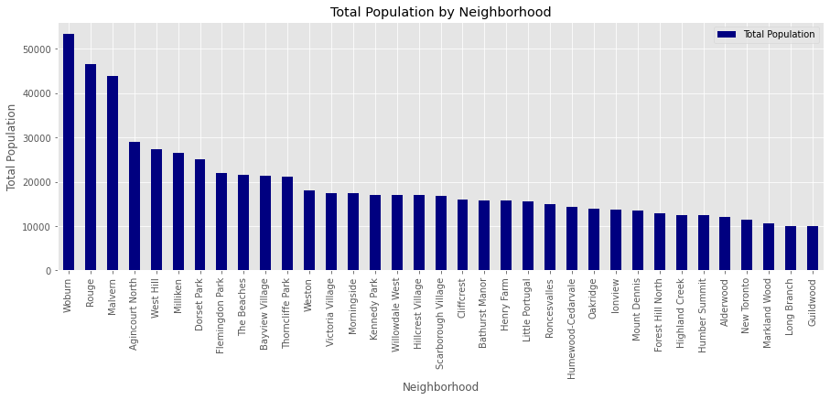
People per neighborhood

Slide 10
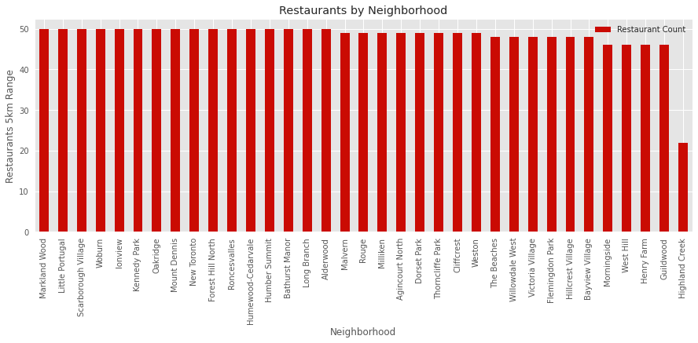
Restaurants

Slide 11


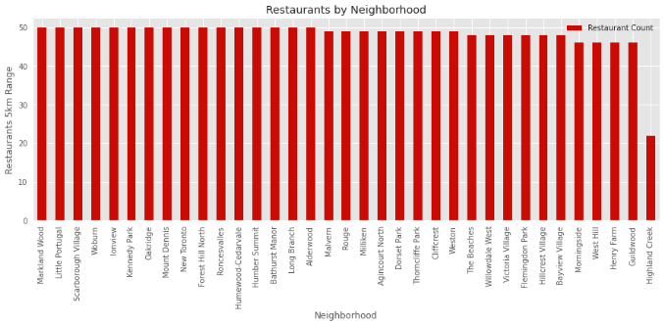
Pre-Evaluation
Woburn shows be the most populated neighborhood, with a good average income per family in the region.
Based on that, we can see that could be the best place to deliver business services.

Slide 12
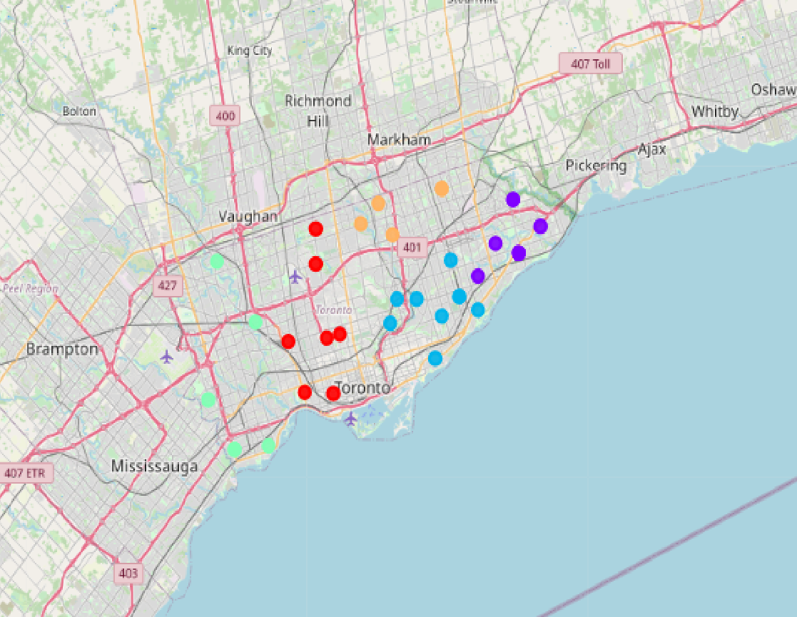
Map with Clusters
Clustering labels to be used in our analysis

Slide 13
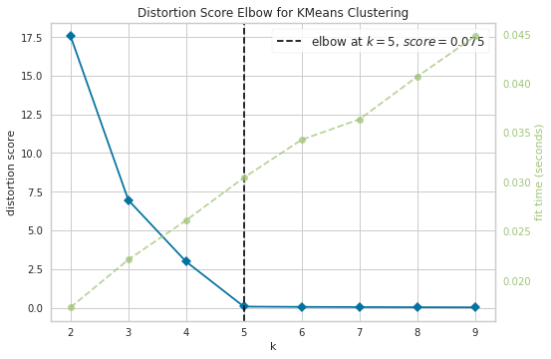
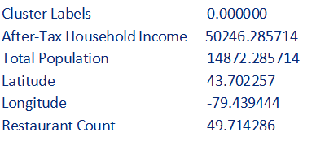
KMeans Cluster Analysis

Slide 14
All Clusters labeled
Here we can start to see the key cluster for our goals

Slide 15
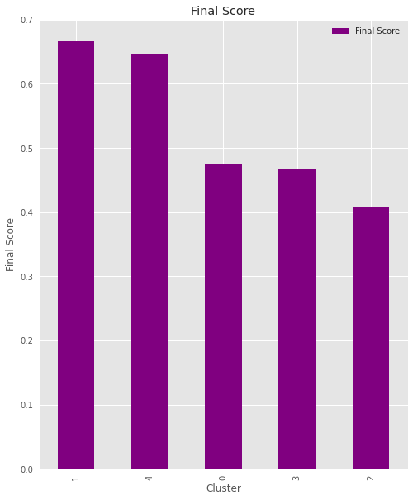
Final Score for the Clusters
Cluster 4 is the best region for us to help the restaurants to implement the new delivery services, followed by cluster 1.
2
1

Slide 16
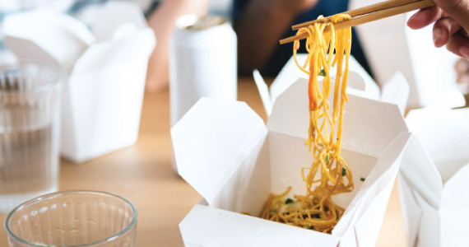
Conclusion
The model is very consistent, and shows be a good customizable tool
External factors to this analysis can impact the implementation results:
Franchises that can operate into the same range
Population average age and origin
Operations: quality of products, delivery time, fees, etc.)
Suggestions to the small business
Run marketing on social medias and network
Owners' resilience for the current and former situation
Keep attention to the competition
Don’t start a “price” war
Peep the Customer Experience highest

Slide 17
Conclusion
Forecasting the services
We do not believe that even after the lockdown, the model will become obsolete once the lockdown ends, as people will certainly see the social value of helping small businesses and creating jobs in their regions. Even if people go back to work in offices, we believe that small restaurants can offer this service at a cost differential for the consumer, who is already used to the same service done before.

Slide 18
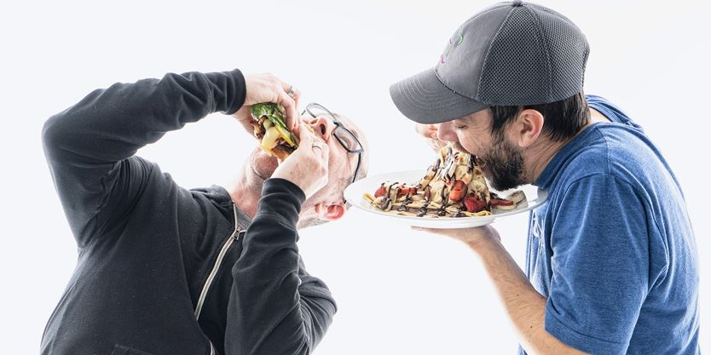
Thank You !

